Slide 1
Recruitment
JCI Mem. Gian Paolo Cheang
2014 Regional Training Director
2013 LO President – JCI Daraga

Slide 2
Strengthening Your Local Organization
Chapter Management and Administration
Recruitment and Retention
Chapter Meetings

Slide 3
Recruitment
Do we NEED to recruit?
Is there VALUE in recruiting new members?
How does one go about recruiting others to his cause?

Slide 4
WHO AM I?

Slide 5
Recruitment = Courting
HARANA

Slide 6
HARANA
H ighlight the Good
A nchor your strategy to your identity
R esearch your prospects
A ssure that you’re a good match
N urture the connection
A rouse their passion
Notes:
6

Slide 7
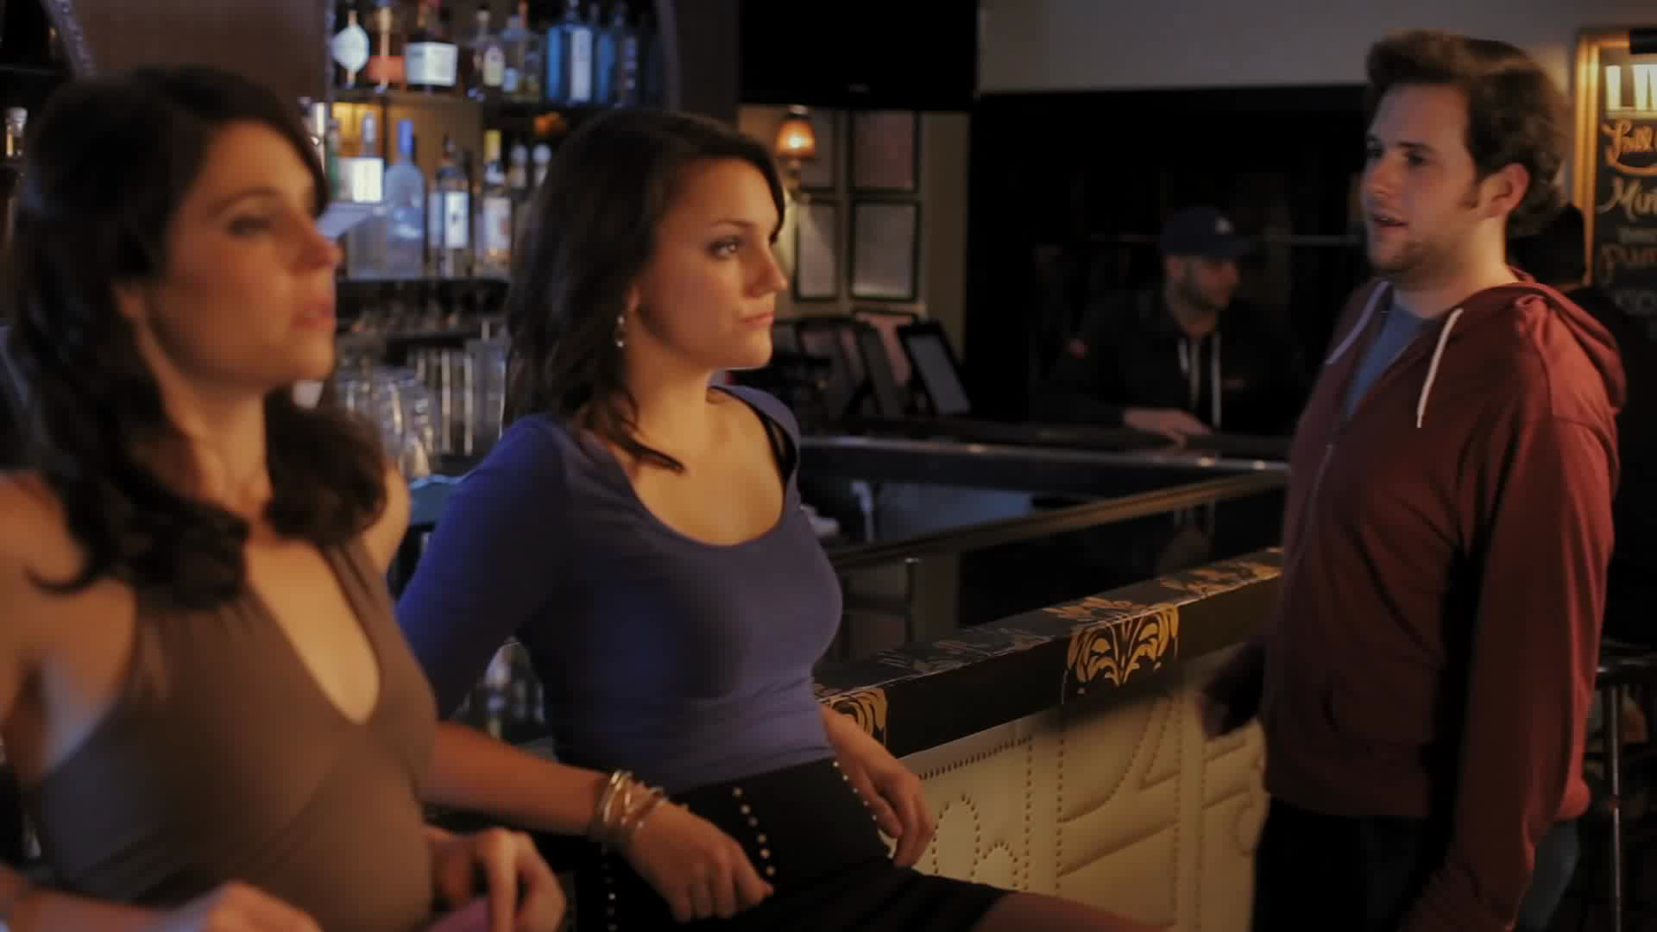

Slide 8
Highlight the Good
Build up your Image
- Vehicle - Quality projects
- Flowers and chocolates
PDA – Public Display of Anger

Slide 9
Anchor your strategy to your Identity
Establish your LO identity
The president and the chapter
Set goals
Culture and credibility
The First date – NMO
The wingman

Slide 10
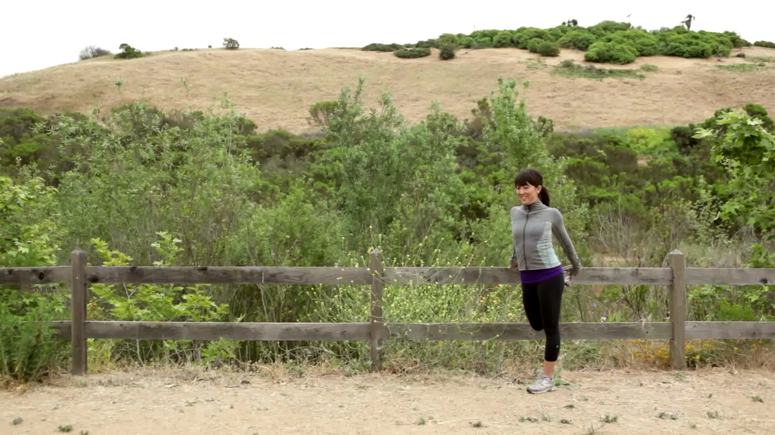

Slide 11
Research your prospects
Heat chart
Blonde or brunette?
First base
Initial contact
Listen

Slide 12
Assure you’re a good match
Actions speak louder than words
assurance
The perks
We have everything

Slide 13
Nurture the connection
Building a relationship
Organization
Chapter
Members
The bridge

Slide 14
Arouse the passion
Involvement
Leadership ladder
Deliver what you promise

Slide 15
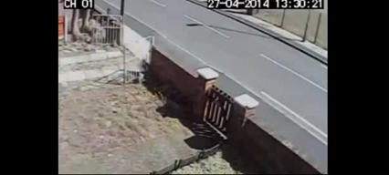

Slide 16
Thank You
Notes:
To use this particular slide more than once in your presentation you must first copy and paste it because it is not a master and simply selecting new slide will not make it appear again.
Once you have done this follow the steps listed below to add a new picture that is relevant to your presentation:
1. Click anywhere on the black box so it is highlighted
2. Then ‘right click’ on it and choose – ‘send backward’ from the ‘order’ menu
3. Next, click on the photo of Zsolt and hit ‘delete’ on your keyboard
4. Now, using the Insert menu at the top, insert a picture onto the slide
5. Size your picture to fit approximately over the space of the white spaces in the black box – make sure your picture is not larger than the black box or you will see it.
6. When you are happy with the size of the photo, right click on your picture and choose ‘send backward’ from the ‘order’ menu.
*The picture should now be showing only in the white spaces of the black box. If this is not the case, repeat step 6
7. If it still doesn’t work – try again from the beginning
IMPORTANT NOTE: The slide is arranged so that the white spaces and black box are one image. Using the transparency tool we have turned the white color transparent allowing for any image under it to show through.

